Slide 1

Department of Computer Science Gujarat University
M.Sc.(Artificial Intelligence & Machine Learning) – IV
Sign Language Recognition
Presented By:
Singh Suraj Arvind (40016)
Under the Guidance of :
Dr. Jyoti Pareek

Slide 2
Objective
Communication is always having a great impact in every domain and how it is considered the meaning of the thoughts and expressions that attract the researchers to bridge this gap for every living being.
The objective of this project is to identify the symbolic expression through images so that the communication gap between a normal and hearing impaired person can be easily bridged.

Slide 3
Introduction
The world is hardly live without communication, no matter whether it is in form of textual, voice or visual expression.
The communication among the deaf and dumb people is carried by text or visual expression.
Gesture communication is always in the scope of confidential and secure communication.
Sign language is learned by deaf and dumb, and usually it is not known to normal people, so it becomes a challenge for communication between a normal and hearing impaired person.

Slide 4
Dataset Description and Exploration
The dataset format is patterned to match closely with the classic MNIST. Each training and test case marks a label from 0 to 25 as a matched map for every alphabetic letter A-Z (and no cases for 9=J or 25=Z due to gesture motions). The training data (27,455 samples) and test data (7172 samples) are approximately half the size of the standard MNIST but otherwise similar with a header row of the label, pixel1, pixel2…. pixel784 which represents a single 28x28 pixel image with grayscale values ranging 0-255.
The dataset seems balanced as for each training label, and enough training examples exist shown in Figure on the next side that we obtained during the exploration of the dataset.

Slide 5
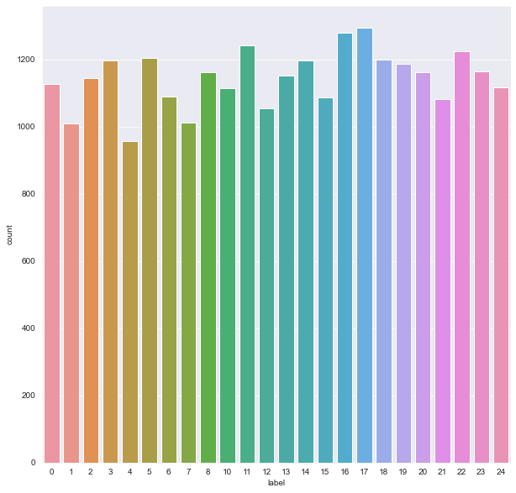

Slide 6
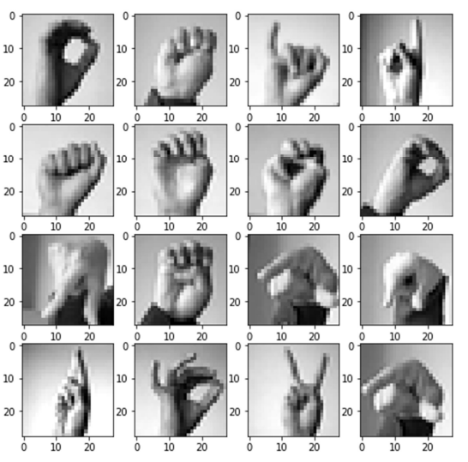
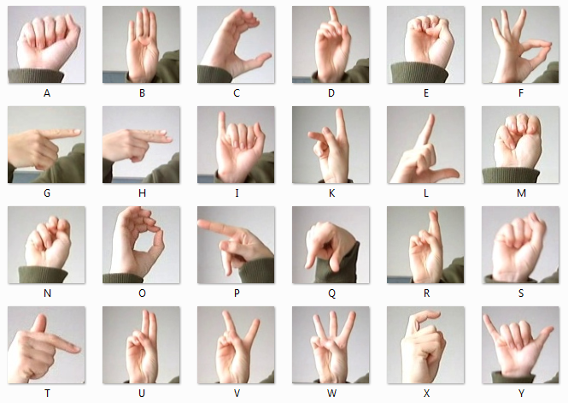
Images of the Dataset

Slide 7
Steps for model construction and validation
Exploring the dataset
Building the CNN Model
Training and validating the model with the training dataset
Testing the model with testing dataset

Slide 8
Architecture
A
B
C
Max Pooling
(2 x 2)
Y
Max Pooling (2 x 2)
Max Pooling (2 x 2)
Convolution(128)+ReLU
Dropout(28)
Softmax
Convolution (32)+ReLU
Convolution(64)+ReLU
Flatten
Dropout(128)
Input Image

Slide 9
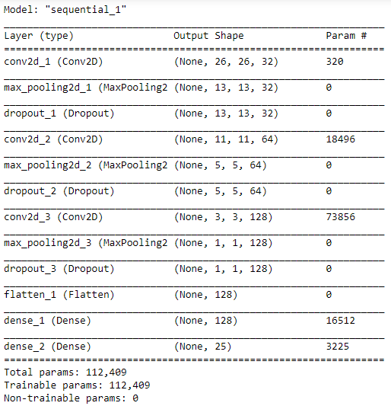
Model Summary

Slide 10
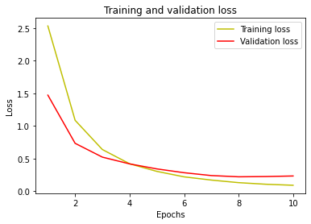
Training and validation loss

Slide 11
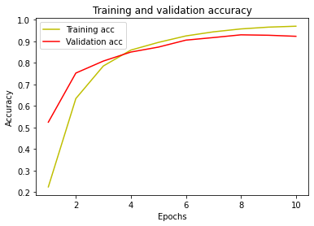
Training and validation accuracy

Slide 12
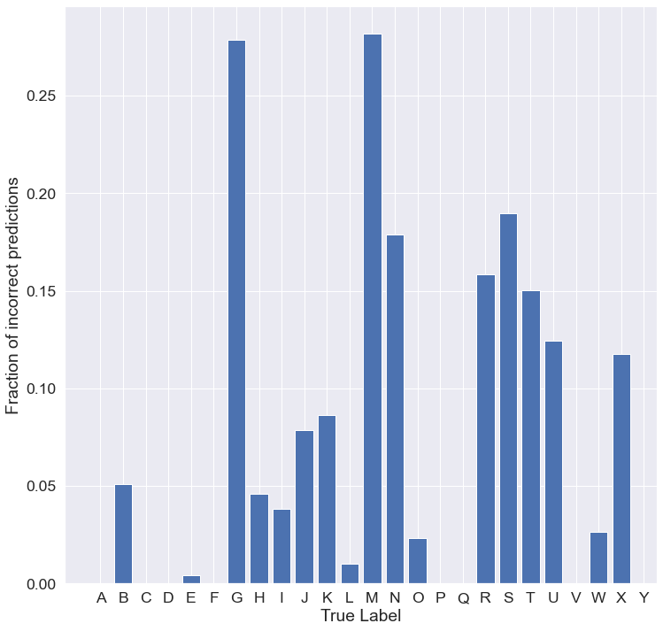
Plot fractional incorrect misclassifications

Slide 13
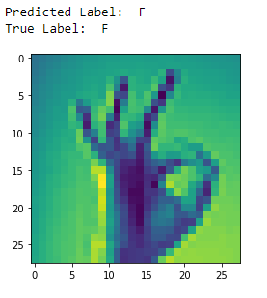
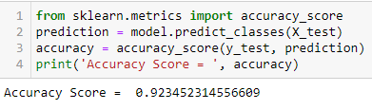
Predict and Accuracy

Slide 14
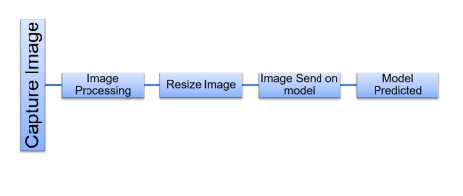
DETECTION PROCESS CAMARA

Slide 15
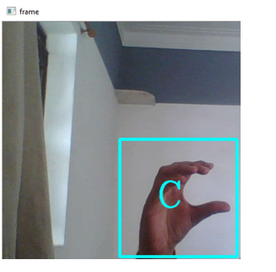
Predict Using Camera

Slide 16
Future Reference
Future study may extend our work to accept video frames to include letters j and z in the classification so that more varied inputs can be processed and understood by the network.
Furthermore, there is a need for a large public dataset for automatic sign language recognition to utilize new deep learning techniques and a better way to benchmark performance

Slide 17
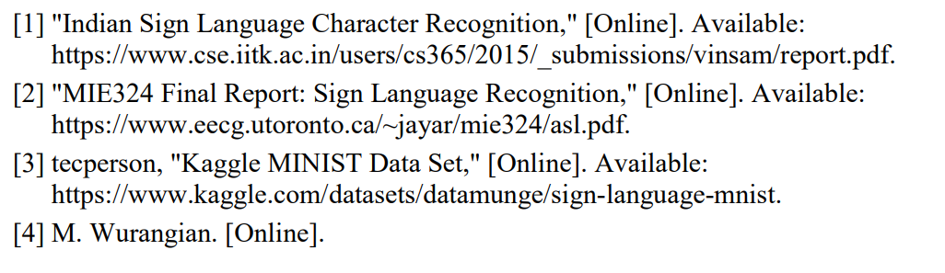
References

Slide 18
